Slide 1


Modelling, Control, and Experimental Validation of a Ball and Plate System
Prepared by: Mohammed S. Baayou
Supervised by: Dr. Ali S. ElMelhi

Slide 2
Table of contents
01
02
03
04
05
06
Introduction and Motivations
Plant Selection and Implementation
Mathematical Modeling
A bierif overview and some motovations sights
Mechanical and electrical parts and design
Langrangian modeling and linearization
Control Design
Results Analysis
Conclusions
PID controller tuning and designing
Responses and results with discussion
Conclusion recommendations and future work

Slide 3
01
Introduction and Motivation

Slide 4
Control Theory
“ a science concerned with the study of systems, in terms of their stability, their response to external factors, methods to control them and represent them mathematically in an appropriate manner.“

Slide 5
ECEP
EXPERIMENTAL CONTROL EDUCATIONAL PLANTS
magnetic levitation plant
Inverted pendulum system
tank level system
ball and beam system

Slide 6
Ball and Plate Balancing System (BPS)

Slide 7
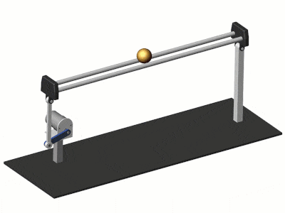
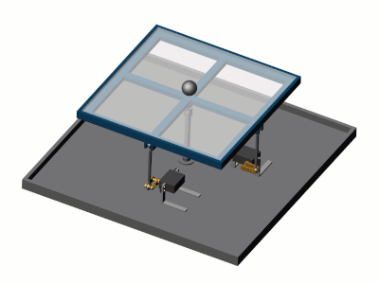
Ball and Beam
Ball and plate

Slide 8
BPS advantages
Portable
Safe
Affordable
Clear response observer
Unstable
Convenient
Controllable
Scalable

Slide 9
02
Plant Selection and Implementation

Slide 10
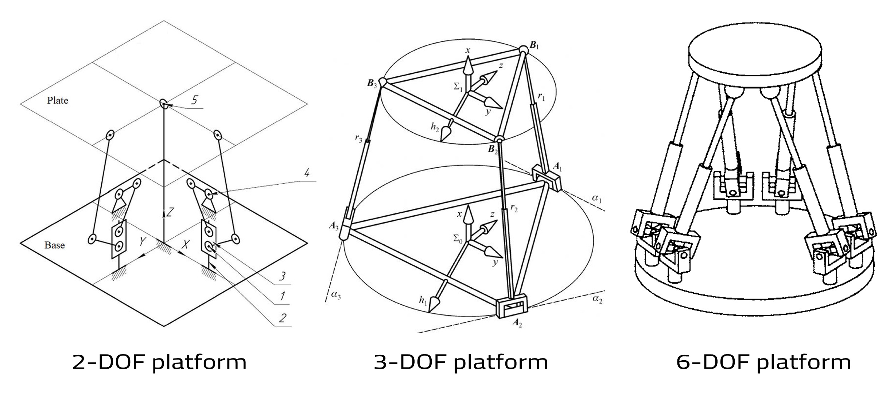
Plant selection based on degree of freedom
2 DOF
3 DOF
6 DOF

Slide 11
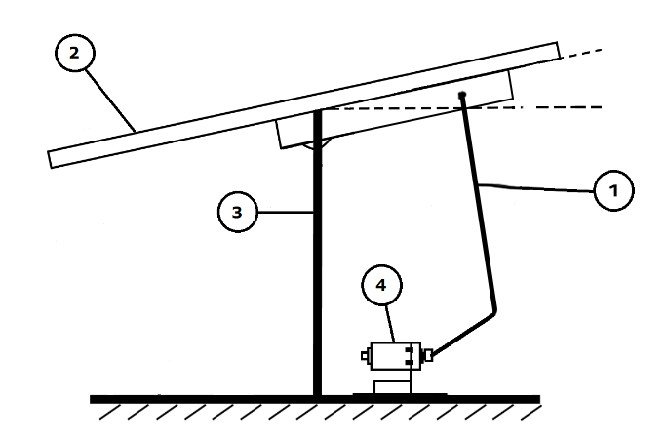
Mechanical design
Linkage Rods
1
A linkage part between the actuator and the plate
Plate
2
Transparent plastic flat platform in 200mm x 2mm dimension
Base and Universal Joint
Actuator holder
3
4
Pivotal connection allowing the plate to move around two axis
A simple aluminium structure that holds the actuator in place

Slide 12
Electrical parts selection
Sensor
Camera
Resistive touch screen
Infrared sensor
Electrical parts
Actuator
Servo motor
Stepper motor
DC motor
Microcontroller
Arduino
PC via simulink
PCB circuitry

Slide 13
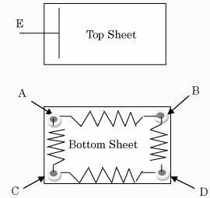
Five Wire Resistive Touch Screen

Slide 14
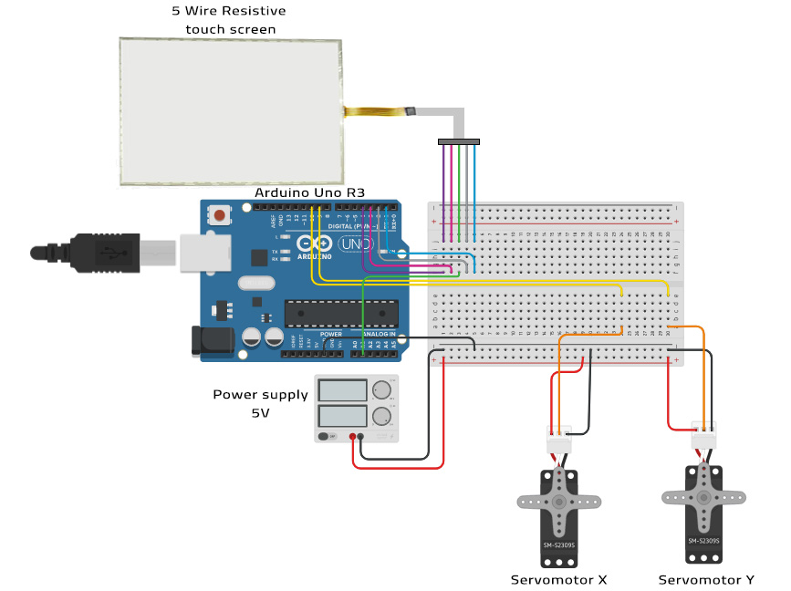
Electrical connection

Slide 15
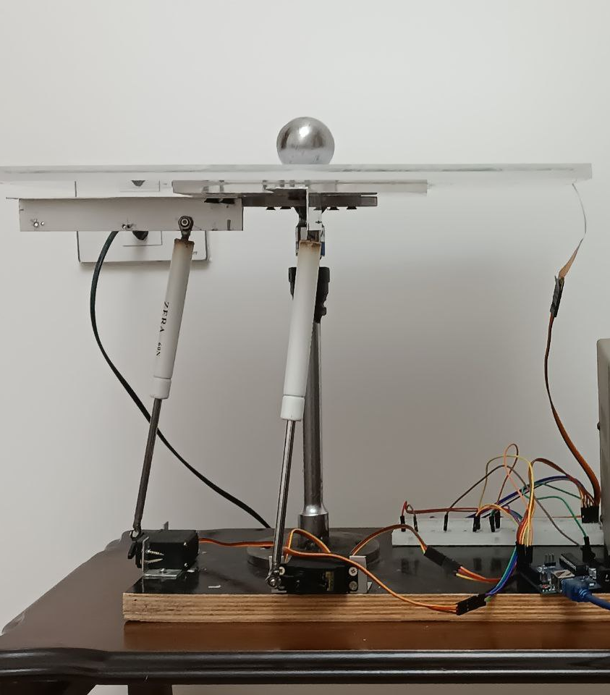
The final form of the BPS system
This image reveal the final appearance of the system with a steel ball resting on top of it

Slide 16
03
Mathematical Modelling
In this section the mathimatical of servo and BPS and linearization efforts will be disscussed

Slide 17
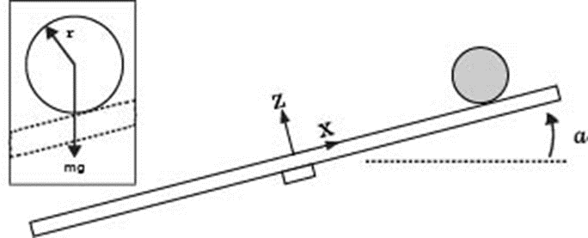
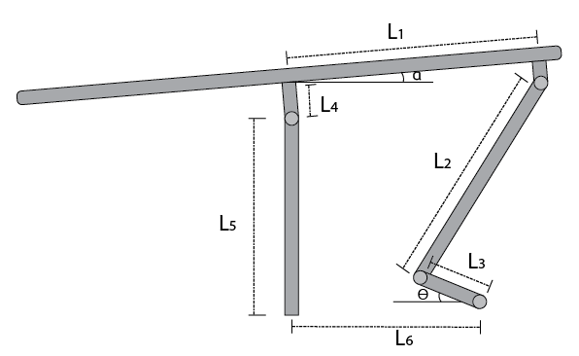

The system is divided into:
Plate and Ball
In which alpha is the input and ball position is the output
Linkage rod
Gain that converts theta into alpha
Servomotor
Which is the servo internal system

Slide 18

Assumptions
All friction forces are neglected
the ball is symetric and rounded
The plate has infinite surface

Slide 19
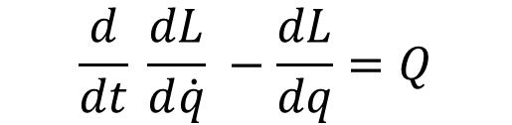
Euler Lagrange Formula
$$\frac{d}{dt} \frac{dL}{d\dot{q}} −\frac{dL}{dq}=Q$$

Slide 20
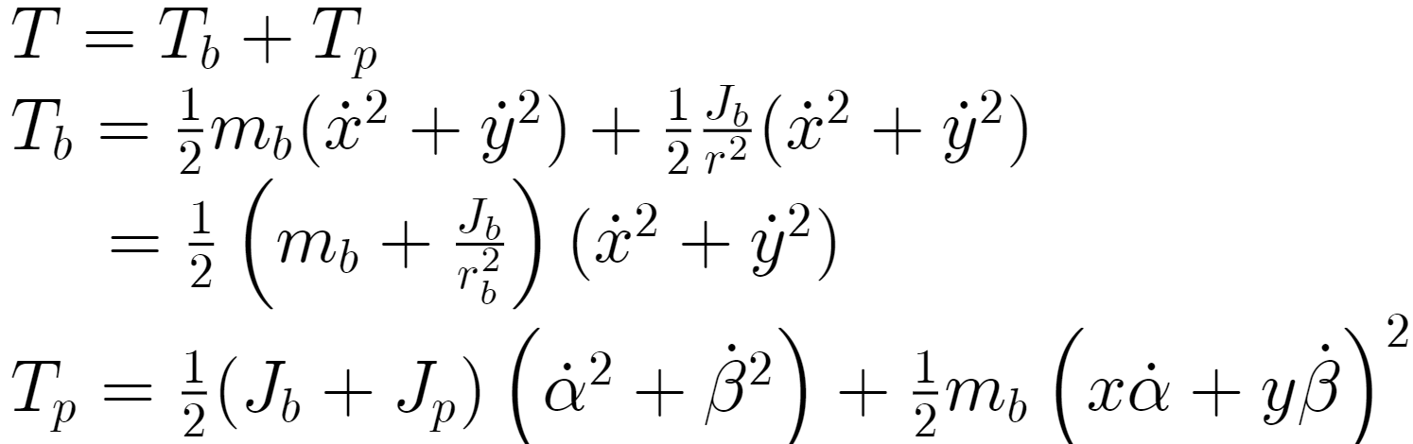
Kinetic and potential energy

Slide 21
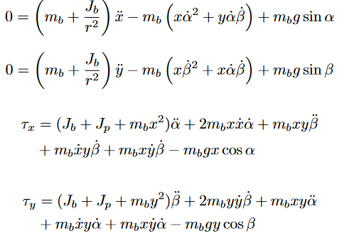
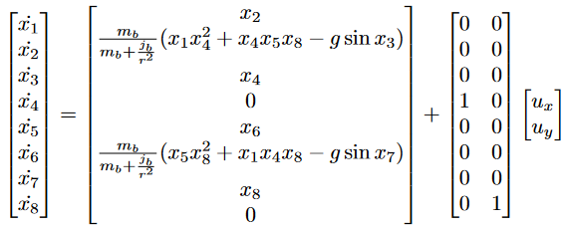
Equation of motion
Differential equations
In state space

Slide 22
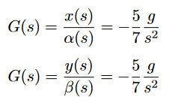
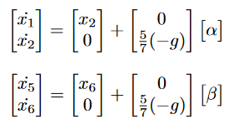
Simplification and linearization
Simplification assumption
Linearized model
The inclination angles assumed to be small < 15 therefore sine(ɑ) = ɑ
The motor doesn’t lose any steps and load doesn’t affect their performance
The ball is solid spherical object

Slide 23
Linkge gain
Mapping table
Servo motor angle | Inclination angle alpha | Inclination angle beta
0 | -7.9 | 7.3
5 | -7.8 | 7.0
10 | -7.6 | 6.8
15 | -7.2 | 6.6
 | ......
85 | 0.8 | -1.7
90 | 1.3 | -2.3
95 | 2.0 | -2.9
 | …….
145 | 9.0 | -9.0
150 | 9.6 | -9.3
180 | 10.5 | -10.2
Mapping the angles and using linear polynomial regression:
Kx = 0.0445 Ky = 0.0377

Slide 24
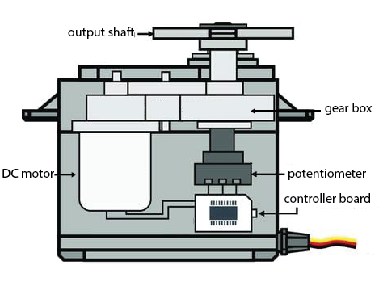
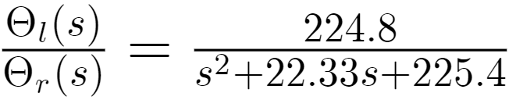
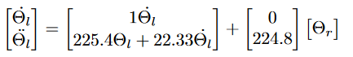
MG995 Servomotor

Slide 25
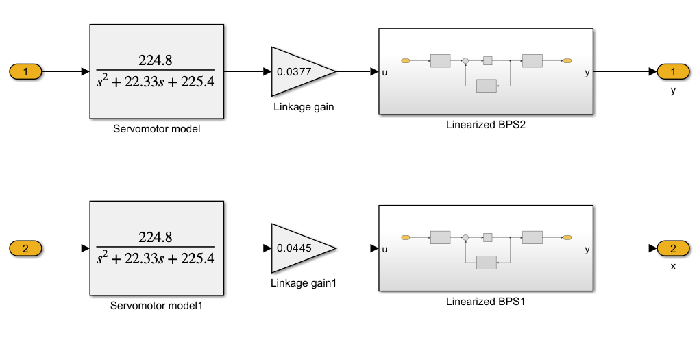
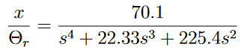
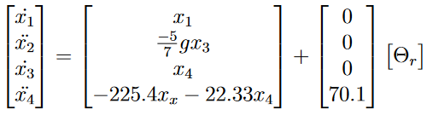
Overall model
Taking in account the linearized plant model and the actuator model with the linkage gain

Slide 26
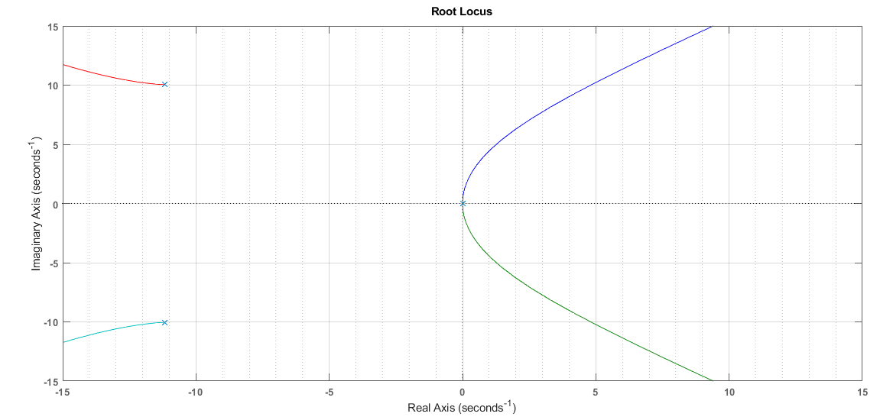
Root locus with no controller

Slide 27
04
Control Design and Challenges

Slide 28
Designing steps
01
02
03
Analyzing
Simulation
Experimental
Controllability check, Rootlocus analysis
Simulink modeling and tuning
Implementation and testing via simulink and arduino

Slide 29
Control Requirements
the plate to incline only in 12~ deg in both coordinates.
Settling time: less than 5 seconds
Rise time: less than 1 seconds
Overshoot: less than 20%
Steady state error: less than 0.1%

Slide 30
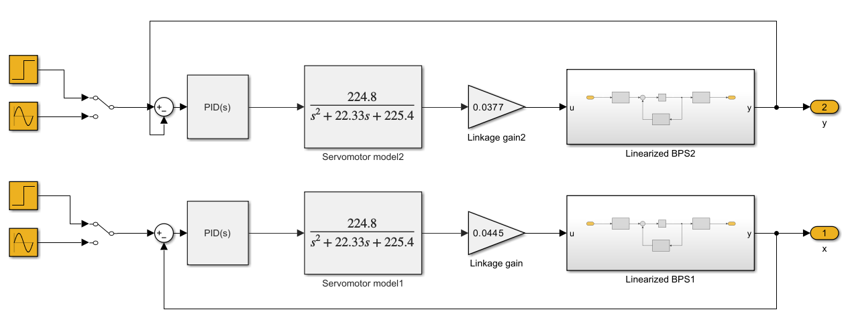
Continuous time Simulink model for PID controller

Slide 31
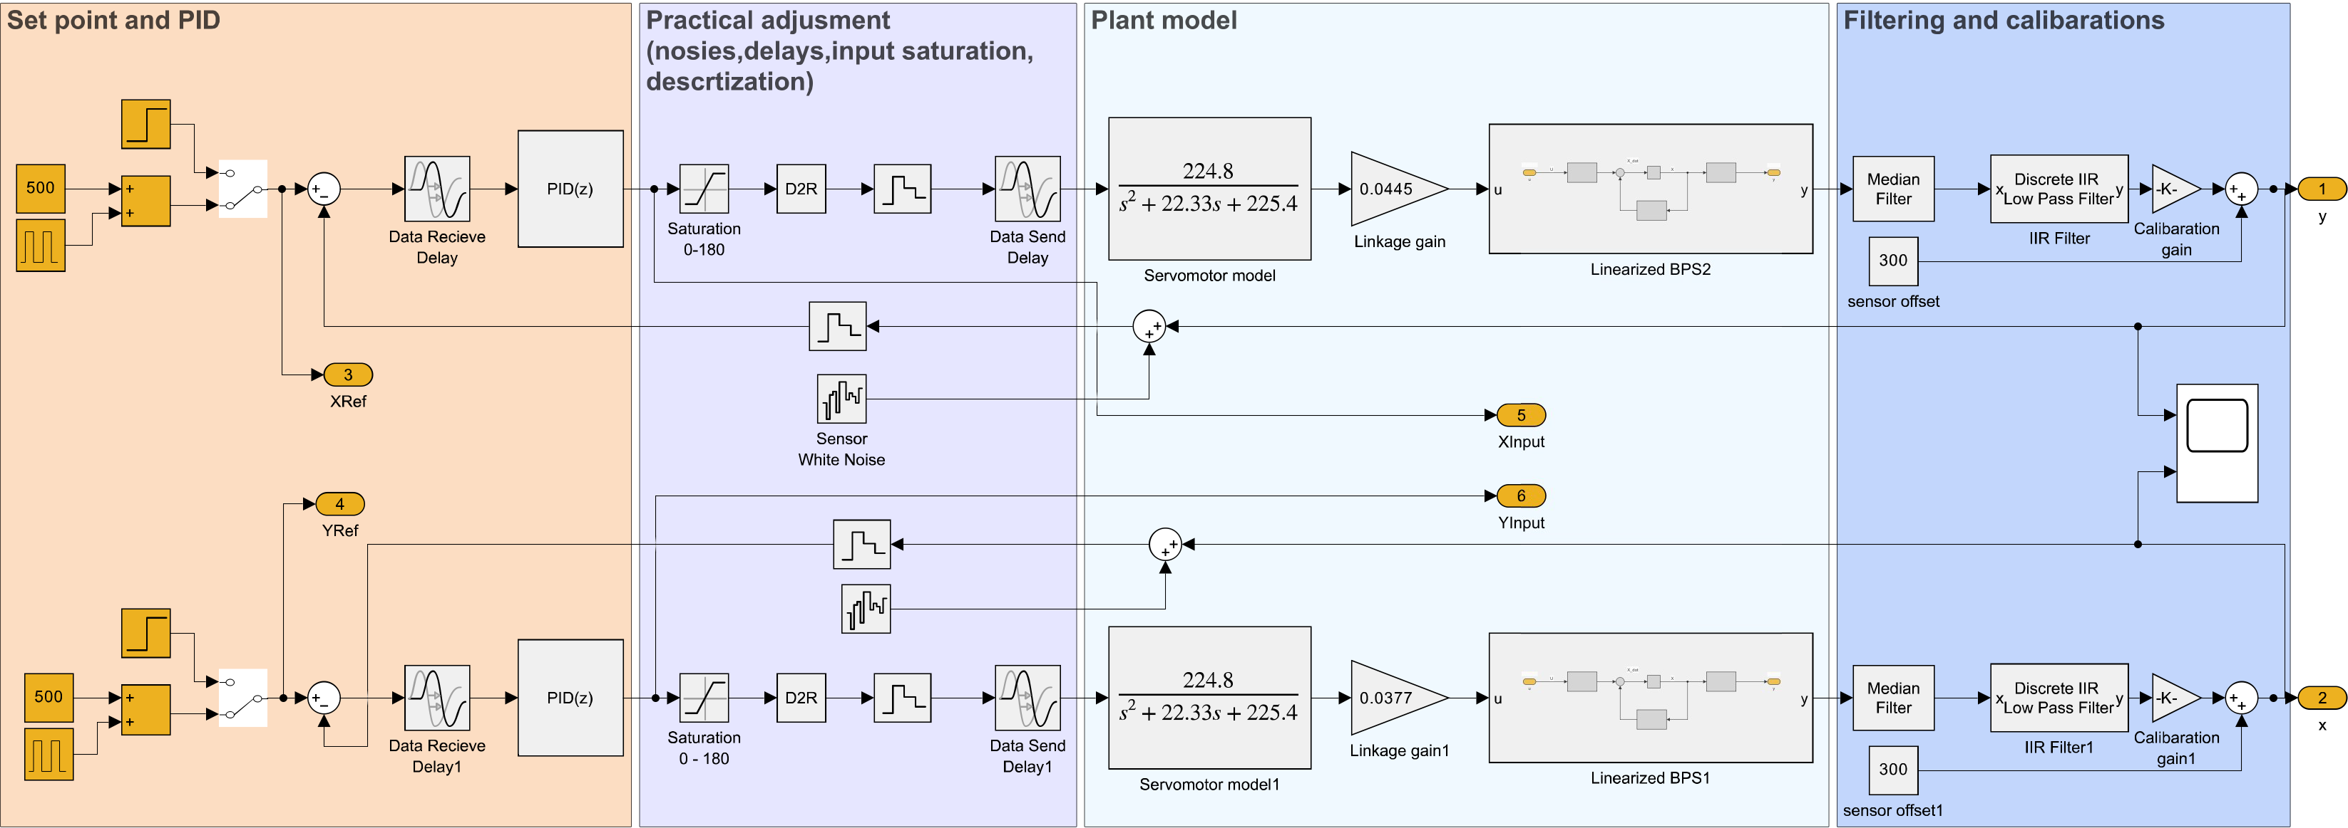
Discrete simulink model with practical adjustment PID

Slide 32
Tuned PID parameters
 | Prpotional gain | Integral gain | Derivative gain
PID X 1 | 0.125 | 0.00184 | 0.098
PID Y 1 | 0.127 | 0.00084 | 0.088
PID X 2 | 0.165 | 0.00085 | 0.11
PID Y 2 | 0.167 | 0.00084 | 0.105
PID X 3 | 0.105 | 0.00084 | 0.07
PID Y 3 | 0.107 | 0.00184 | 0.069

Slide 33
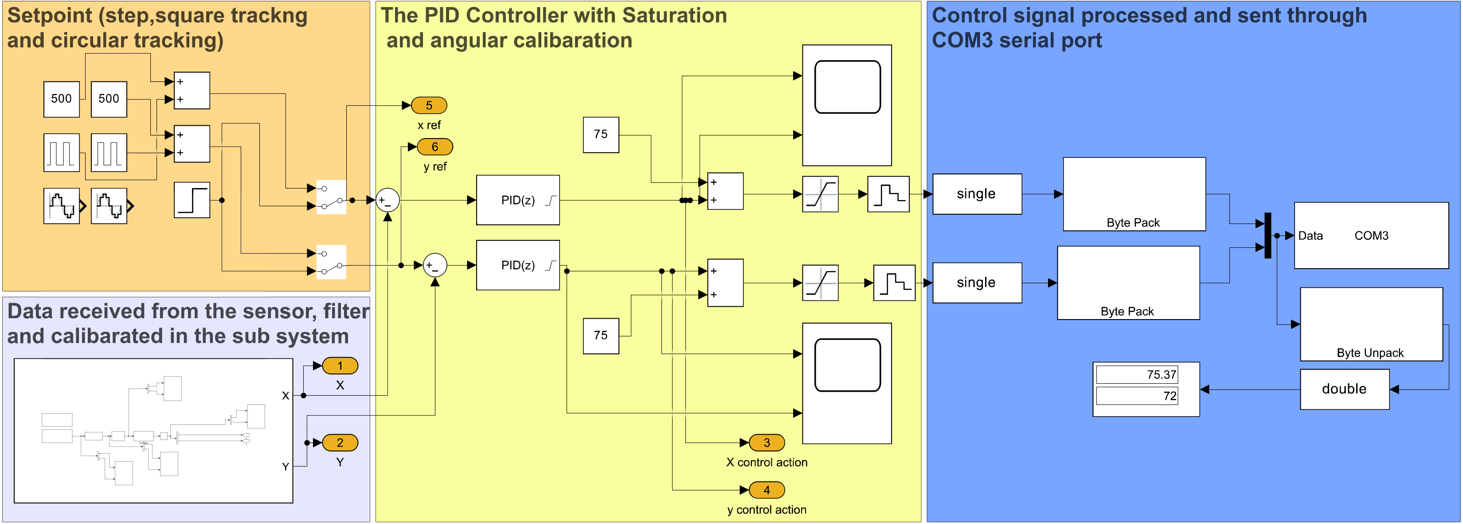
Simulink model with practical adjustment PID

Slide 34
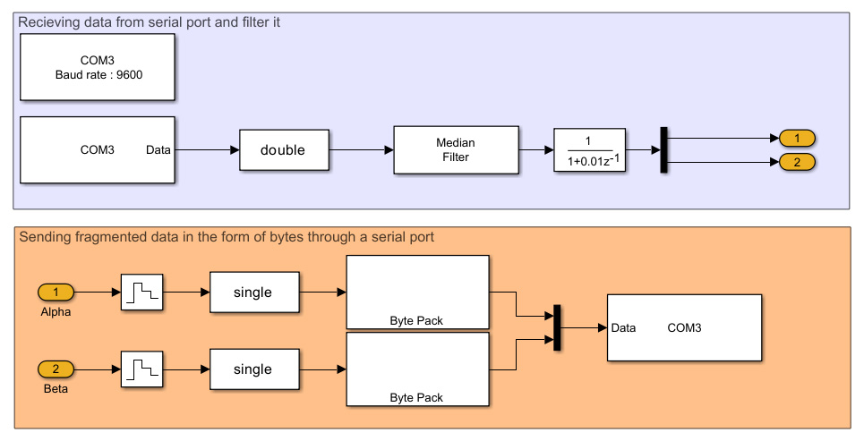
Challenges and limitation
Connecting Arduino with Matlab
To connect arduino with matlab serial communication was used, this may cause a transpotation delay

Slide 35
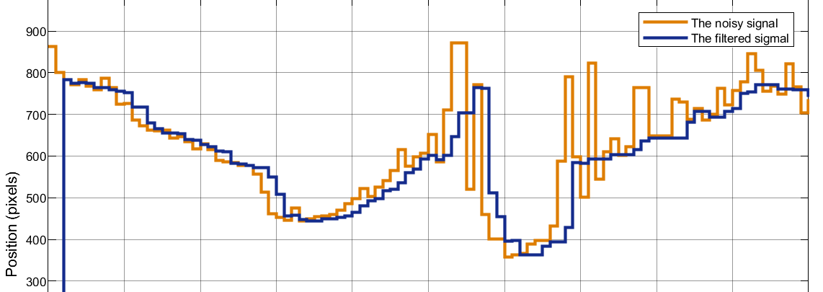
Challenges and limitation
Sensor noises and filtering delay
To eliminate signal noises 3 filters was applied:
Arduino code detect when a touch happen
Athematic median filter with 3 windows size
Low pass filter

Slide 36
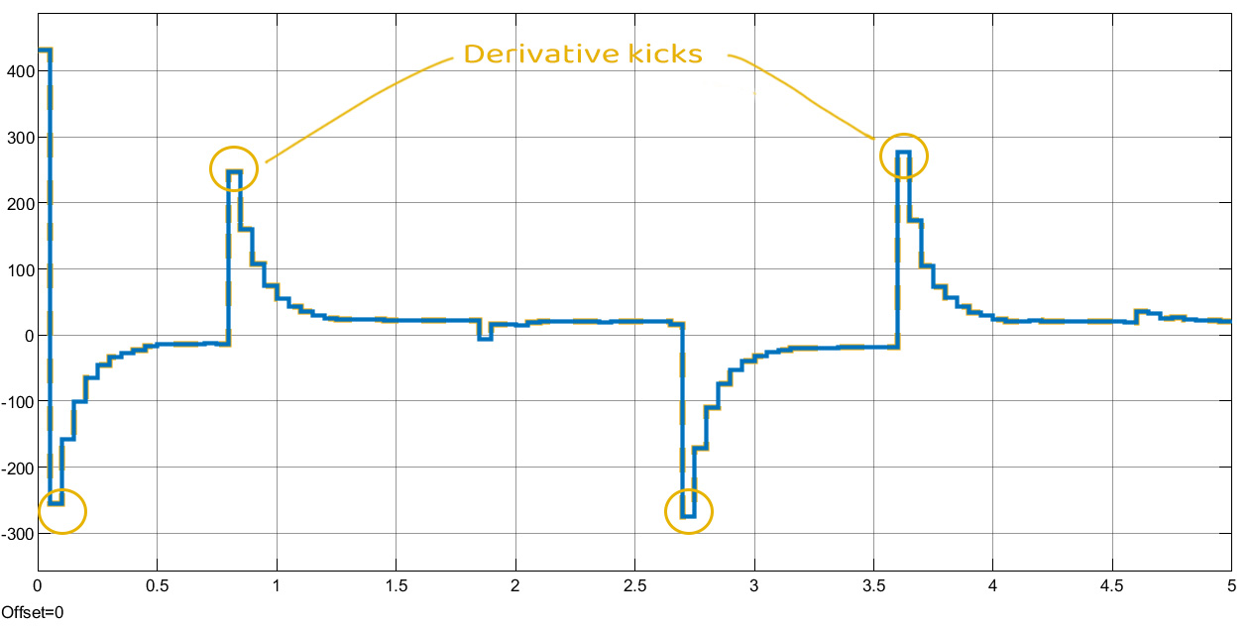
Challenges and limitation
Derivative kicks and noises degradation
The suddenly changes in setpoint or the input make an undesired phenomenon called Derivative kicks

Slide 37
05
Results and Validation

Slide 38
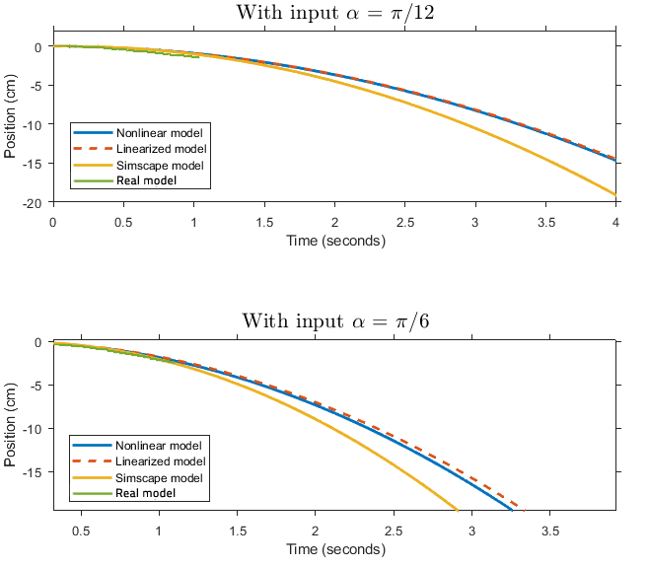
Validation of modelling and linearization

Slide 39
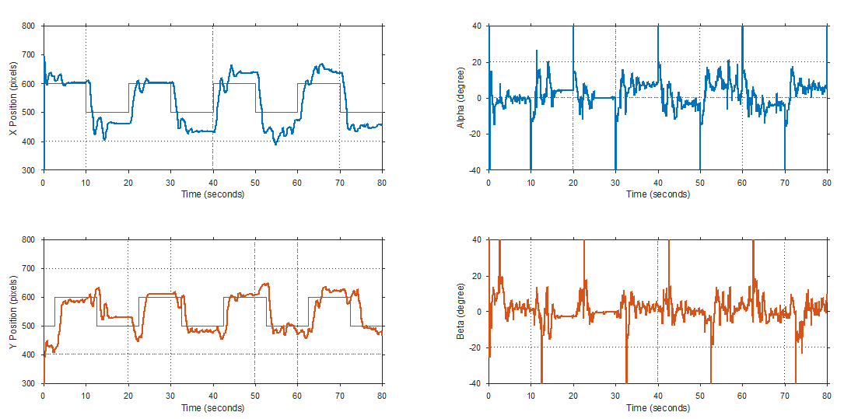
Experimental response and control action

Slide 40
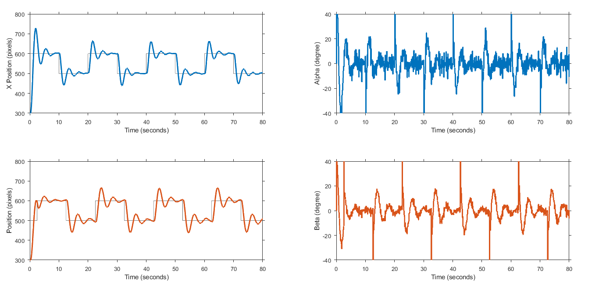
Simulation response and control action

Slide 41
06
Conclusions and Recommendations

Slide 42
Conclusions and Future work
Conclusion
Future work
We were able to build the entire ball and plate system from locally availble parts, despite that the local market still lacks high quality electronic parts
We were able to design a PID controller for the system that satisfies the purpose and gives relatively good response, however there were limitations and challenges in the PID controller caused by the D term
There were differences between the simulation and the real results, and this may be due to several reasons, including: bad servo accuracy, structural vibrations, asymmetric ball
The system’s performance can be improved by changing the sensor and relying on better approach e.g. overhead high quality camera
More advanced linear or nonlinear controllers can be explored such as MPC, LQR, Fuzzy logic or slide mode to achieve better performance and response
Optimizing the structure also can lead to a better responses

Slide 43
Thanks!
Do you have any questions?

